Slide 1
Change the first word of the third pair in the same way as the other pairs to give a new word
Example: bind, hind bare, hare but, hut
11 pit, pot lit, lot hit,______
12 hit, hat sit, sat pit,______
13 bat, bet sat, set mat,______
14 pen, pan men, man fen,______
15 dig, dog fig, fog big,______ bog
hot
pat
met
fan
bog
Notes:
Paper1 11-15

Slide 2
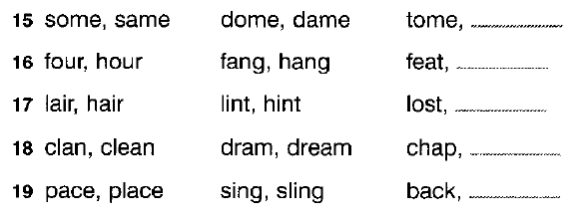
Change the first word of the third pair in the same way as the other pairs to give a new word
Notes:
Paper12 15-19

